Slide 1
AI Food Recipe & Nutritional Chart Generator
A Generative AI Project
Submitted by: Gouri Rabgotra (102203732) & Anisha Sharma (102203860)
Submitted to: Dr. Jyoti
B.E. 4th Year - COE, Computer Science and Engineering Department
Thapar Institute of Engineering and Technology, Patiala
November 2025

Slide 2
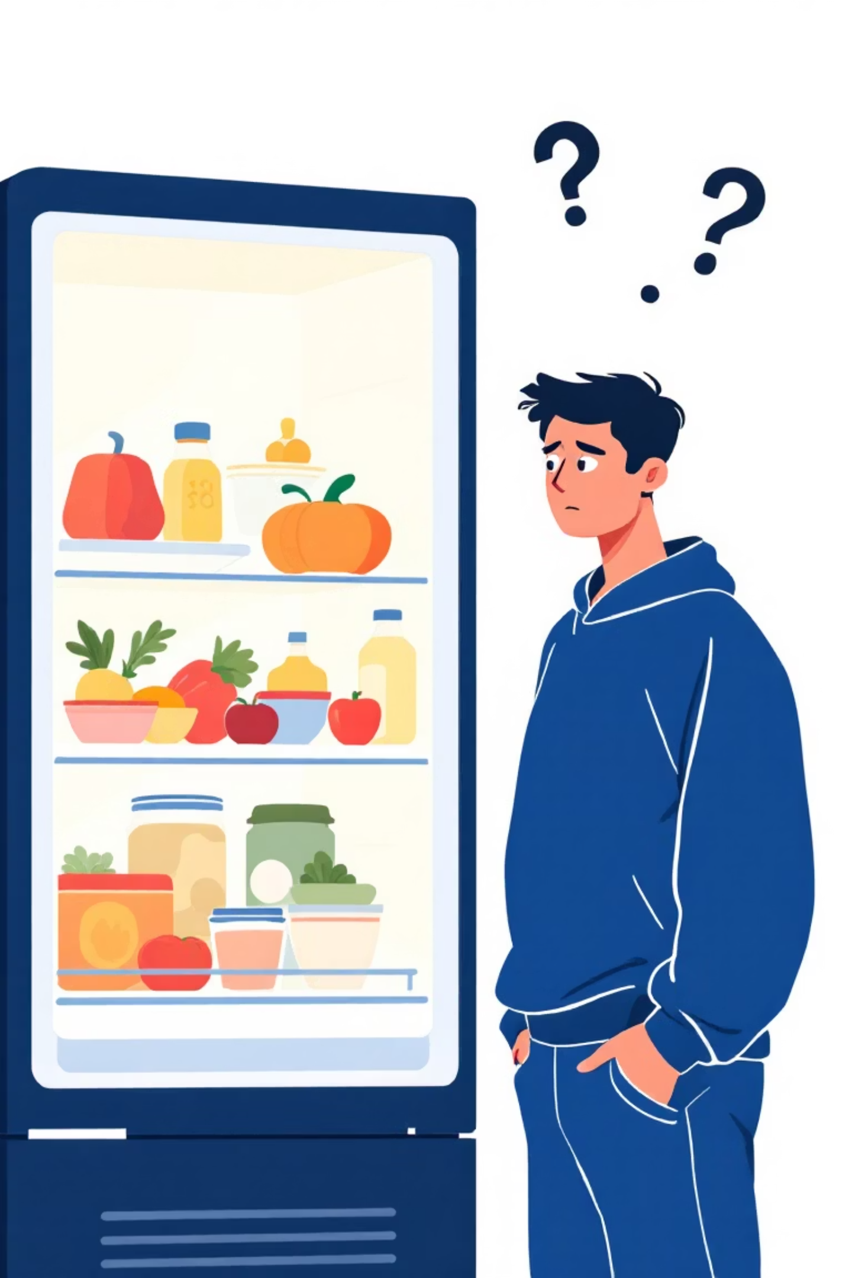
The "What to Cook?" Dilemma
Many home cooks face significant culinary challenges in their daily lives.
Recipe Repetition
Users often have a variety of ingredients at hand (e.g., paneer, spinach, onion) but lack the inspiration to combine them into new dishes, leading to repetitive meals.
Nutritional Unawareness
When trying new recipes, understanding the health impact is challenging. The nutritional content—calories, protein, and fat—often remains a mystery.
Current recipe applications are primarily static search engines, not creative assistants. They struggle to adapt to specific ingredients and cannot combine dynamic recipe generation with instant nutritional analysis.

Slide 3

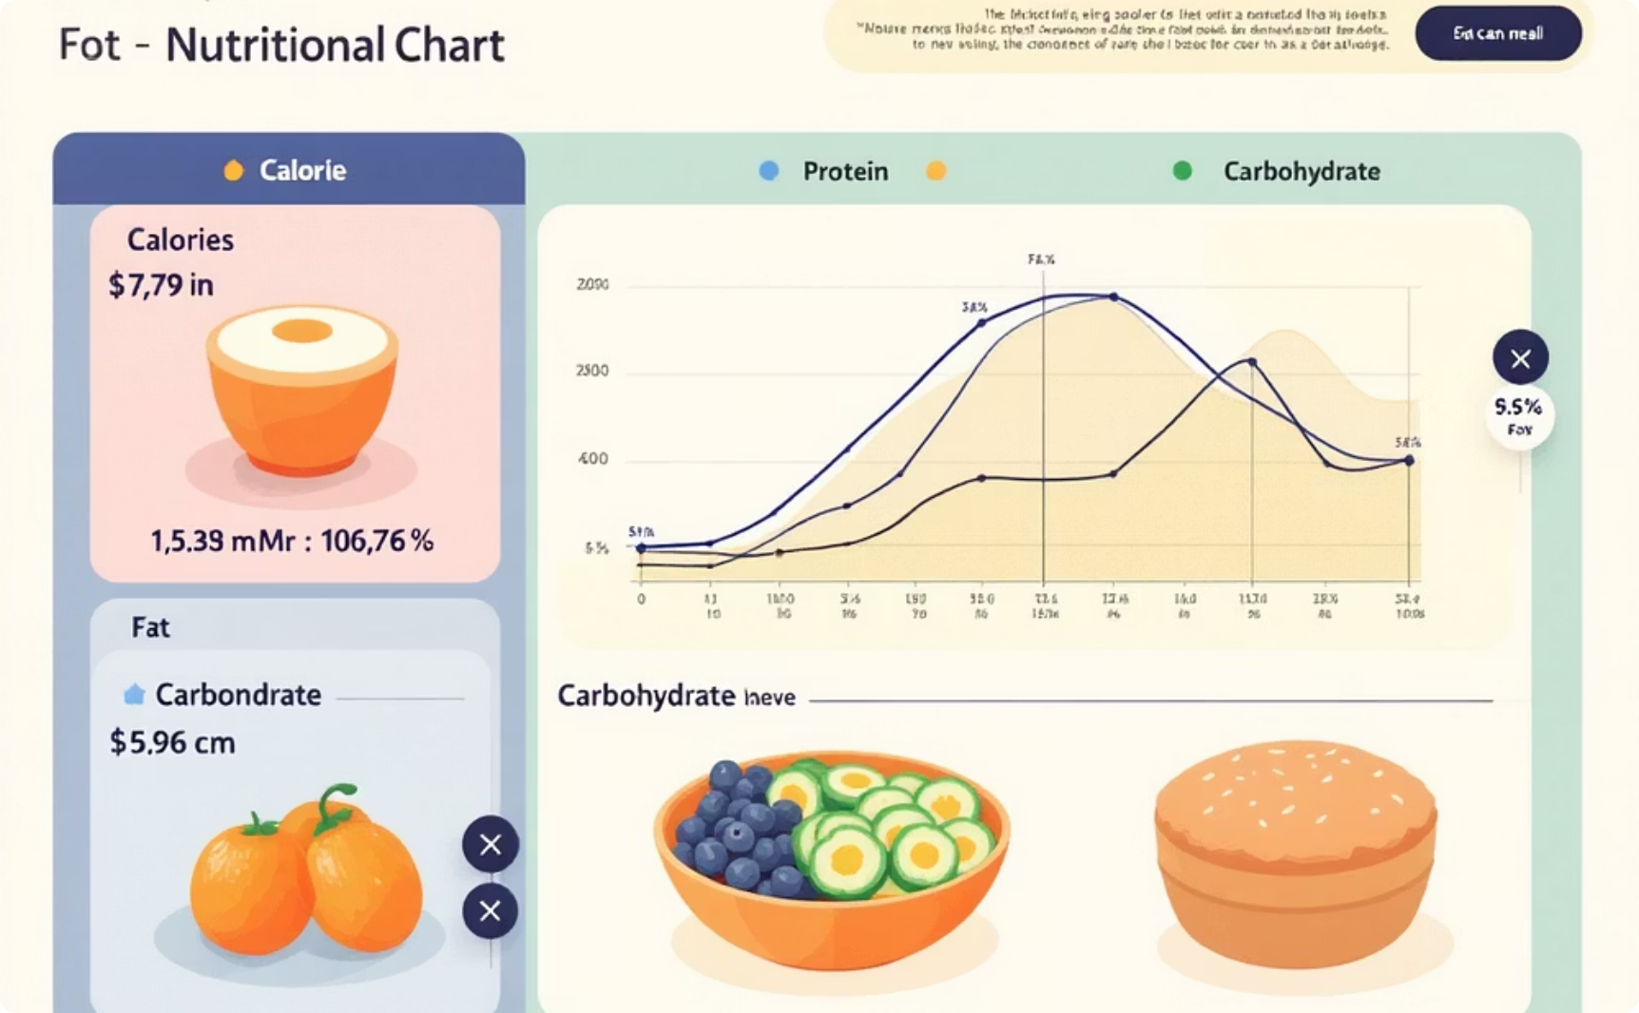
Our Intelligent Recipe & Health Assistant
We are developing a web application designed to bridge this culinary gap, acting as a creative partner in the kitchen.
Dynamic Recipe Generation
Instant Nutritional Analysis
The system takes any set of user-provided ingredients and generates a complete, unique, and creative step-by-step recipe.
Simultaneously, it provides a detailed, easy-to-read nutritional chart, breaking down calories, protein, fat, and carbohydrates for that exact recipe.
This project seamlessly connects the act of cooking with essential health and nutritional awareness, offering a practical tool for everyday living.

Slide 4

Project Approach & Architecture: Local-First AI System
Our architecture is designed for powerful, self-contained operation, running entirely on the user's machine for privacy and efficiency.
Enter Ingredients
Python Backend
AI Engine
Display Results
This local-first approach ensures responsiveness, data privacy, and a seamless user experience without reliance on external API calls.

Slide 5

Code & Logic Explained: Python's Role
Our streamlit_app.py script orchestrates the entire process, serving as the central "brain" of the application.
Calculation & Display
Parsing & Extraction
The script iterates through the extracted ingredient list, fetching nutritional values (currently from a mock database). It then sums these totals and presents both the generated recipe and the comprehensive nutritional chart via Streamlit.
Prompt Engineering
Our Python code uses Regular Expressions (re) to efficiently identify and extract the JSON block from the AI's single string response. This JSON is then parsed into a Python list of ingredients and quantities.
Instead of simple queries, we use a detailed system prompt to instruct Llama 3 to output content in a strict two-part format: a machine-readable JSON block and a human-readable recipe.
This structured approach ensures accurate data handling and a smooth user experience from ingredient input to final display.

Slide 6

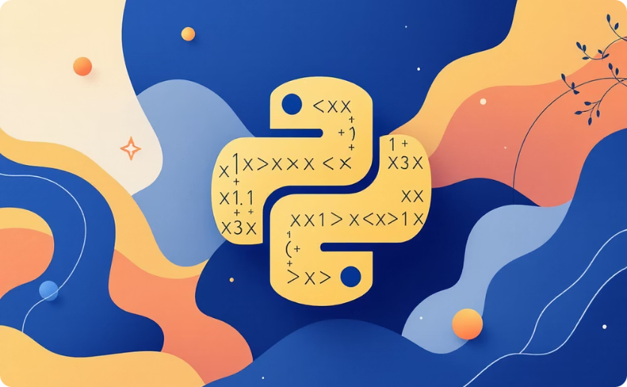


Technology Stack: Our Culinary Toolkit
We have selected a modern, robust, and flexible technology stack to power this innovative GenAI project.
AI Engine
Backend & Logic
Front-End
Version Control
Ollama: Facilitates running powerful Large Language Models (LLMs) locally.
Python: The foundational language for all core logic, data processing, and application functionality.
Streamlit: A Python-only framework, ideal for rapid development and deploying our interactive web application with a clean user interface.
Git & GitHub: Utilised for comprehensive source code management, collaborative development, and maintaining a public repository for our project.
Llama 3: Our chosen Generative AI model, celebrated for its advanced reasoning and text generation capabilities.
Ollama Python Library: Enables seamless communication between our Python scripts and the Ollama engine.
Regular Expressions (re): Essential for robustly parsing structured output from the AI model.

Slide 7

Key Features: What We've Built
Our application offers several distinct advantages, delivering a highly functional and user-friendly experience.
Dynamic Recipe Generation
Creates unique recipes from any ingredient list, moving beyond static databases.
Instant Nutritional Analysis
Provides immediate breakdowns of Calories, Protein, Fat, and Carbs for each specific generated recipe.
100% Local & Private
The entire AI model runs on the user's machine, ensuring privacy, zero cost, and no reliance on external APIs.
Simple & Interactive UI
A clean, single-page, and intuitive web interface developed using Streamlit for ease of use.

Slide 8
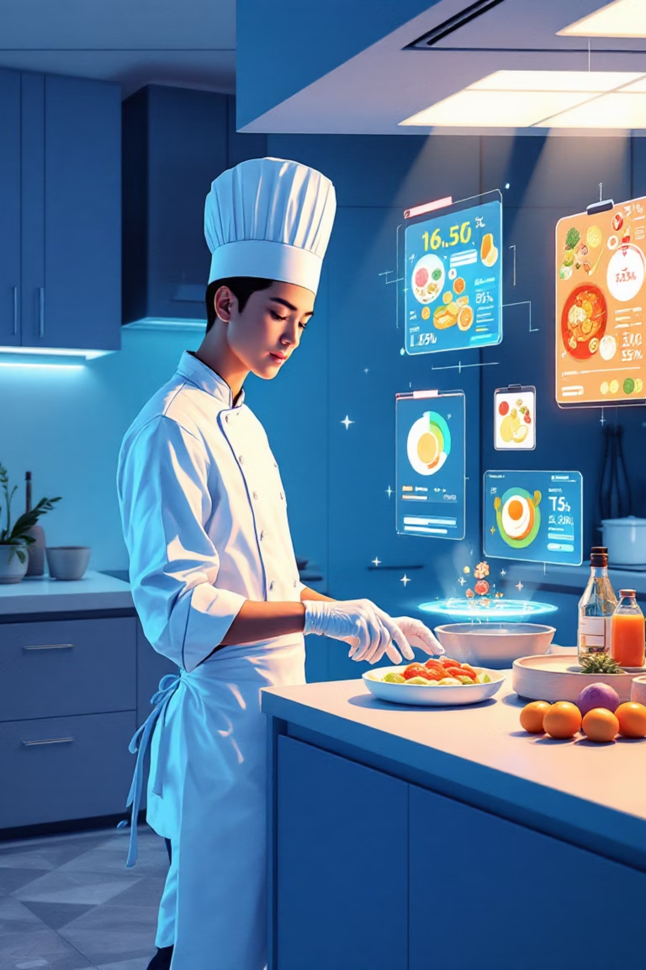
Our Roadmap: Future Work & Enhancements
We have an ambitious plan for future development to further enhance the application's capabilities and reach.
Integrate Real Nutrition API
Replace our current "mock" database with live API calls to the USDA FoodData Central for highly accurate, real-world nutritional data.
Public Deployment
Re-architect the application to utilise a cloud API (e.g., Google's Gemini) and deploy it on the Streamlit Community Cloud for broader public accessibility.
AI Image Generation
Introduce a feature to generate a unique AI-created image (using models like Stable Diffusion) of the final dish for each recipe.

Slide 9

Transforming Home Cooking
Our project aims to empower home cooks by solving the dual challenges of recipe creativity and nutritional awareness.
Beyond Static Recipes
No more endless scrolling or repetitive meals. Our AI generates novel dishes from your available ingredients, making every cooking session an adventure.
Empowering Health Choices
Instantly understand the nutritional impact of your creations, allowing for informed dietary decisions and a healthier lifestyle.
We believe this tool will foster greater culinary confidence and promote healthier eating habits in everyday life.

Slide 10

Thank You
We extend our gratitude for your time and attention to our Generative AI project.
Gouri Rabgotra
Anisha Sharma
Student ID: 102203732
Student ID: 102203860
For more details, please visit our project repository:
github.com/gouri-rabgotra21/genAI_project

